Slide 1
F2FIVE HOME
DRILL
ABOUT
TEAM
Bootstrap header
See: slide 3, 4, & 5
US Healthcare Profile
This app will allow you to see chronic illnesses and age-adjusted death rates by state over time
… blah blah compelling
Some navigation language here about how to use the site
This is the TOP of the homepage
Notes:
1. TOP OF HOMEPAGE

Slide 2
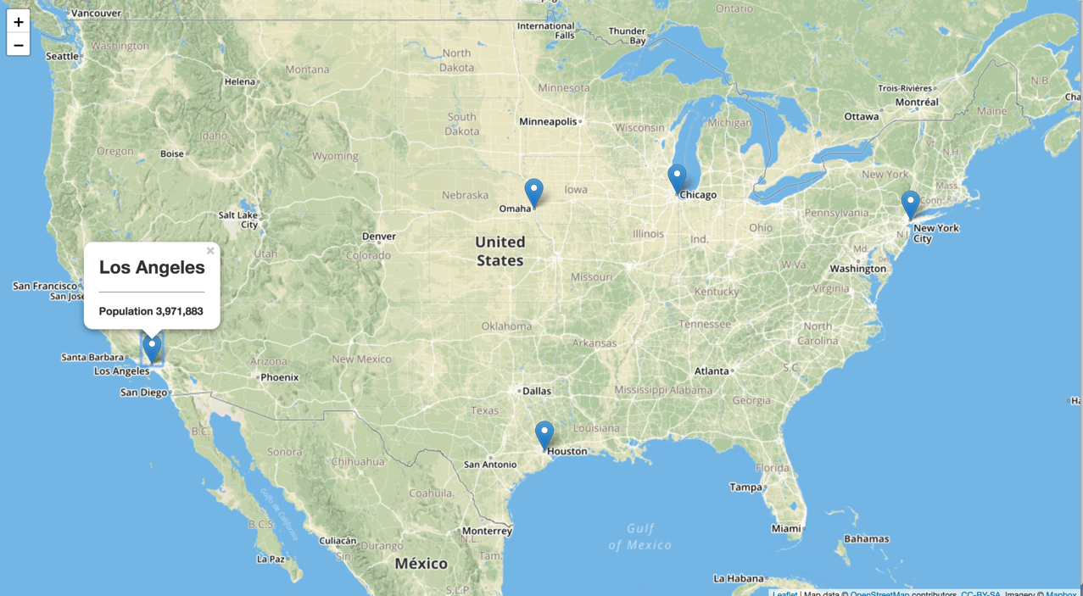

This is the BOTTOM of the homepage
Layer Control:
Clicking diseases to filter
Disease: death rate
Links:
Project source…
Maybe some others
This is the bottom of the homepage
Links:
To the top of the page
© 2018
Notes:
1. SCROLLING DOWN; BOTTOM OF HOMEPAGE

Slide 3
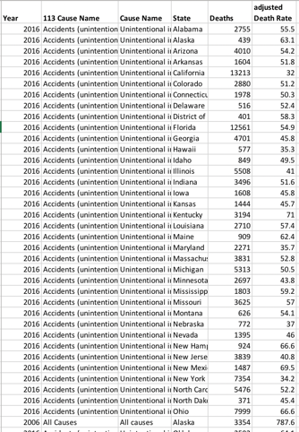
F2FIVE HOME
DRILL
ABOUT
TEAM
Source data: Filters for each category
Pulls from: https://data.cms.gov/resource/ehrv-m9r6.json
Drill Page
Filter
Clear Filter
Summary information will display here
-------------------------------------
A treemap where each cell represents the proportion of deaths by disease controlled by the data filter
Accidents
© 2018
Notes:
2. DRILL-DOWN (the real fun of our project)

Slide 4
F2FIVE HOME
DRILL
ABOUT
TEAM
About page: Proposal language will go here
Inspiration for the project
Potential Hypothesis (if we get that far)
Potential use cases
All data sources and links will go here as well
https://catalog.data.gov/dataset/age-adjusted-death-rates-for-the-top-10-leading-causes-of-death-united-states-2013
© 2018
Notes:
2. ABOUT

Slide 5
F2FIVE HOME
DRILL
ABOUT
TEAM
Team Page
🤨
🧐
😏
🤓
John Commander: * background, * career, * links to portfolio, * linkedin, etc.
John Giglio: … ditto
Bill McGill: … ditto
Jeffrey Box: … ditto
© 2018
Notes:
2. TEAM

